Slide 1


Model Based Granularity Optimization for
High Performance Computing Systems
in Astronomy
By Ophélie Renaud
Reviewers | Examiners | Supervisors
Kevin Martin Christian Perez | Alix Munier Kordon Adam Deller | Jean-François Nezan Karol Desnos
Notes:
_______________________________________________________________
thank you madam President and members of the board of examiners
Hello ladies and gentleman,
and welcome to the defense of my thesis.
I'm Ophélie Renaud, a PhD student at INSA Rennes, supervised by Jean-François Nezan and Karol Desnos.
Today, I'm going to present the results of my last three years of research, entitled “Model-based Granularity Optimization for High-Performance Computing Systems in Astronomy”.
This work was supported by ANR dark era

Slide 2



Square Kilometre Array (SKA)
Preamble
CSP
SDP
Visibilities
Output image
CSP
SDP
CSP: Central Signal Processor SDP: Science Data Processor
Notes:
____________________________________________________________________________________
The context of this thesis is the radio telescope under development, SKA.
SKA consists of antennas in Australia and South Africa, which capture sky signal at different frequencies and process them through a processing pipeline to obtain images of the sky.
The pipeline can be divided into 2 main parts.
The CSP (Central Signal Processor), which converts the voltages from antennas into “visibilities”.
The SDP (Science Data Processor), which converts the visibilities into images that can be analyzed by astronomers.

Slide 3
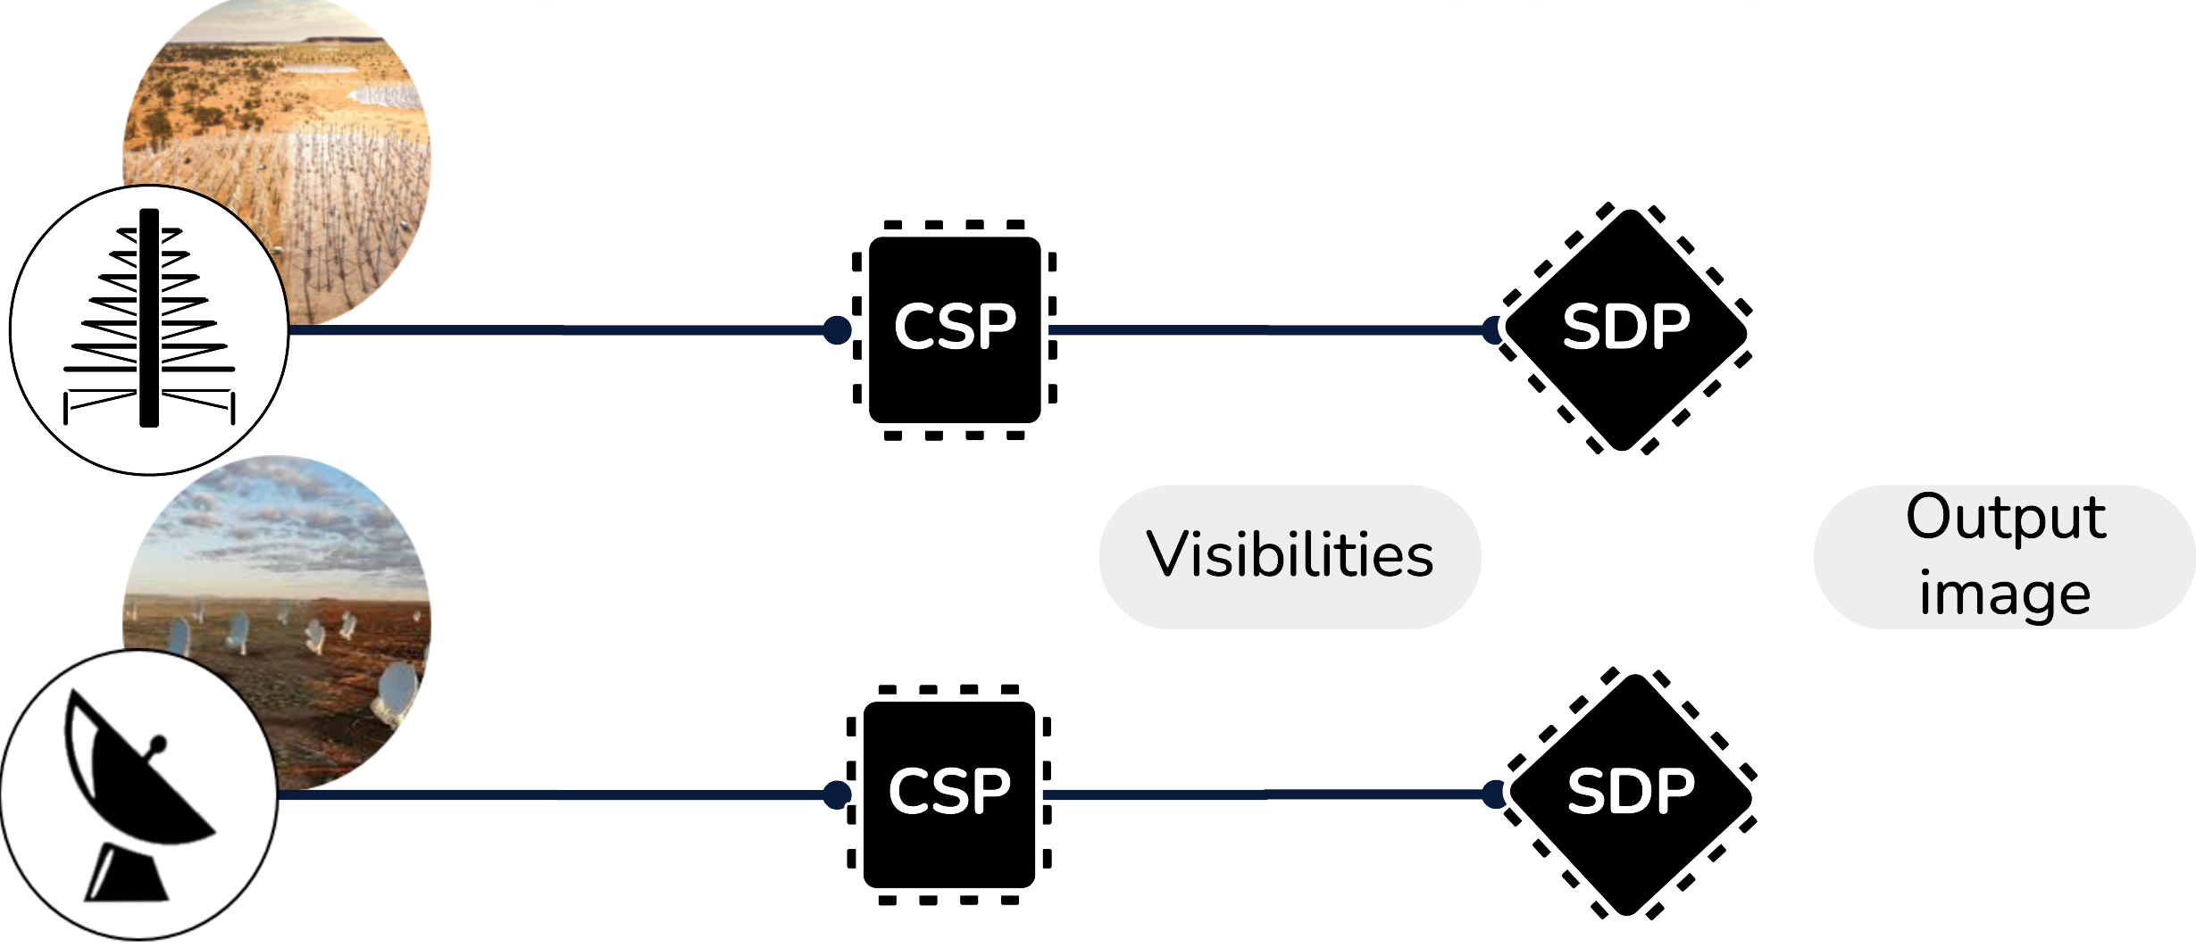
Square Kilometre Array (SKA)
Preamble
2Pb/s
7.8Tb/s
20Tb/s
8.9Tb/s
Huge collecting surface
Storage constraints
Process as fast as possible
Notes:
____________________________________________________________________________________
The SKA, because of the size of its collecting surface, generates an huge quantity of data.
And because of storage constraints, this data has to be processed in as short as possible, this raise a huge challenge in terms of parallel programming.

Slide 4




Not parallel programming expert
Algorithm in development
Not yet built HPC System
SKA objectives
How to optimize the execution of an astronomical application on HPC system?
Notes:
______________________________________
Astronomers are experts in their field, but less so in parallel programming.
So, They are actively developing their increasingly complex algorithms for processing signals from the sky.
But The HPC architectures on which these algorithms will be deployed are not yet built.
And These systems have to meet the real-time constraints imposed by SKA.
These challenge lead to the central question that will unfold of this presentation: “How can we optimize the execution of a program as complex as astronomical on even more complex HPC systems?”

Slide 5

Rapid Prototyping with PREESM
Save Time and Money
Preamble
Functional versions of a program as fast as possible
Notes:
____________________________________
This is where rapid prototyping comes in.
It consist in creating functionnal versions of a program as fast as possible to facilitate testing before final deployment.
PREESM is one such tool, developed in our lab since 2008.
Initially created for embedded systems, I extended it for HPC systems to better serve the needs of SKA astronomers and others.

Slide 6

Notes:
____________________________ In order to understand how, I start to introduce the resource allocation challenges at any scale.

Slide 7



Software Productivity Gap
Introduction
Notes:
As you may know, modern architectures are becoming more and more complex, which on paper improve application performance, but become hard to follow for developers. This introduces a “software productivity gap”.

Slide 8
Graph based Algorithm-Architecture Adequation (AAA)
Introduction
Model of Computation (MoC)
Model of Architecture (MoA)
Adequation
Code generation
[r] C. Erbas, et. al, « Multi objective optimization and evolutionary algorithms for the application mapping problem in multiprocessor system-on-chip design »
Notes:
. ______________________________________
To adress this, we employ a graph based version of the Algorithm-Architecture Adequation method.
This approach models both the architecture and the application as 2 graphs, then applies graph transformations to align them, called "adequation" in french, resulting in optimized parallel code.

Slide 9
Dataflow MoC
Introduction
Expression of several types of parallelism
P
Task //
Data //
Pipeline //
P
A
2
Core1
A
C
A
C
1
1
2
1
1
i+1
i+1
C
D
E
2
D
Core2
B
2
1
B
C
B
C
i+1
i+1
D_1
D_2
Core3
D
E
D
E
i+1
i+1
Independent of the architecture
SDF: Synchronous Dataflow
PiSDF: Parameterized and Interfaced SDF [r] E. Lee and D. Messerschmitt. “Static scheduling of synchronous data flow programs for digital signal processing”.
[r] K. Desnos et. al. "Pimm : Parameterized and interfaced dataflow meta-model for mpsocs runtime reconfiguration"
Notes:
___________________________
On the application side, an effective representation is the dataflow graph where nodes, called actors represents computations and edge represent FIFO buffer.
An extension of this model is the synchronous dataflow model, where integer on the port of an actor indicate the rate of tokens consumed or produced.
One extension of this is the PiSDF, which adds the hierarchy: an actor can be specified by a sub-graph instead of standard C code, and the model integrate parameter to describe rate with an expression.
This models offers many advantages, like expressing several types of parallelism.
task: several actors can run simultaneously (e.g. A and B)
data: several instances of the same actor, can run simultaneously , if there are enough tokens entered (e.g. 2C)
pipeline: by breaking dependencies, the graph can be divided into parallel pipeline stages (e.g. ABC,DE). This is done using a delay , a node, containing the initial tokens at the first iteration of the graph, and then saving the tokens from the previous iteration.
Another advantage is that the model is architecture-independent which means that it is necessary to model once to be portable on any target.

Slide 10
S-LAM MoA
Introduction
Core0
Local Memory
Core0
Core1
Shared Memory
Local Memory
Core1
Router
Distributed Memory
Core2
Local Memory
Core2
At least 2 types of memory architecture modeling
S-LAM: System-Level Architecture Model
[r] Maxime Pelcat, et. al, « A system-level architecture model for rapid prototyping of heterogeneous multicore embedded systems »
Notes:
______________________________
On the architecture side, we use the S-LAM model, which consists in modeling with a very simple model the architecture at system level. Here, the graph is composed of processing elements, communication nodes, connection types and properties.
The S-LAM allow to represent at least 2 types of memory architecture:
Shared memory: all core access a common memory
Distributed memory: each core has its own local memory and communicates with the others via a network.

Slide 11
Adequation - Standard dataflow resource allocation
Introduction
Core0
Shared Memory
Translation
Extraction
Mapping
Scheduling
Timing
Core1
flattening
DAG
x 1
x 2
B0
Ω
C
x 1
x 4
x 2
C0
B1
x 1
x 4
A
B
C
A0
A
B
B2
C1
B3
DAG: Directed Acyclic Graph
Notes:
___________________________
Now that we have our application and architecture models in graph form, let's talk about matching.
Matching consists in allocating resources. The standard resource allocation process focus on multi-core CPU architectures and involves this following steps.
First, the flattening of the application graph: this involves replacing all hierarchical actors by their subgraphs, and putting all actors at the same level.
Then the DAG transformation reveal parallelism and communication. This consists in duplicating each actor by the number of times it is repeated at each graph iteration, and adding special actors to distribute or gather the data consumed/produced by the normal actors.

Slide 12
Adequation - Standard dataflow resource allocation
Introduction
Core0
Shared Memory
Translation
Extraction
Mapping
Scheduling
Timing
Core1
flattening
DAG
x 1
x 2
B0
Ω
C
x 1
x 4
x 2
C0
Core0
B0
B1
C0
B1
x 1
x 4
A
B
C
A0
B2
Core1
A0
B2
B3
C1
A
B
C1
B3
Notes:
___________________________________________
The process proceed by **mapping**, where elements of the DAG graph are placed onto the processing elements (cores) of the target architecture.
Next, it **schedules** the elements by ordering their execution on the processing elements.
Then, it **times** each element, associating an execution time with it.
Finally, the elements are translated into parallel code.

Slide 13
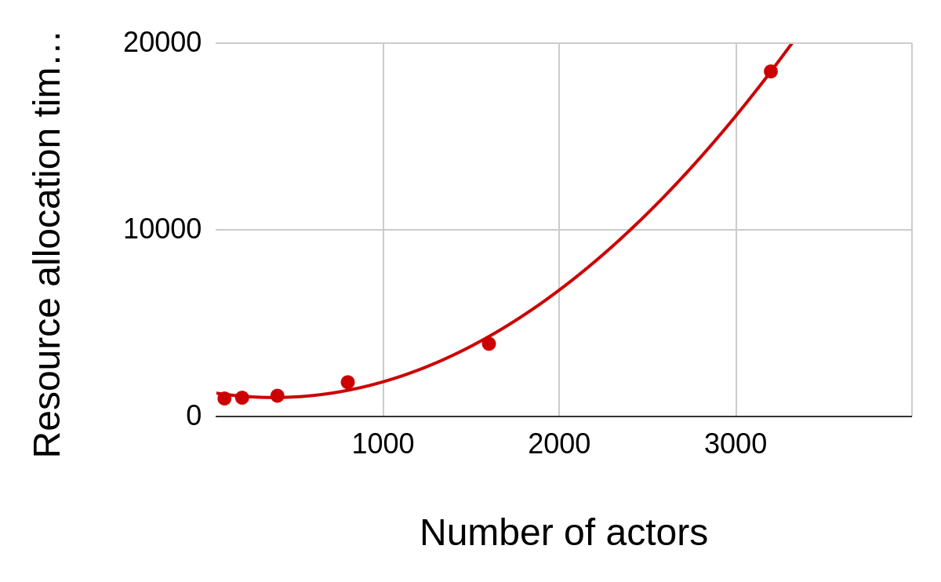
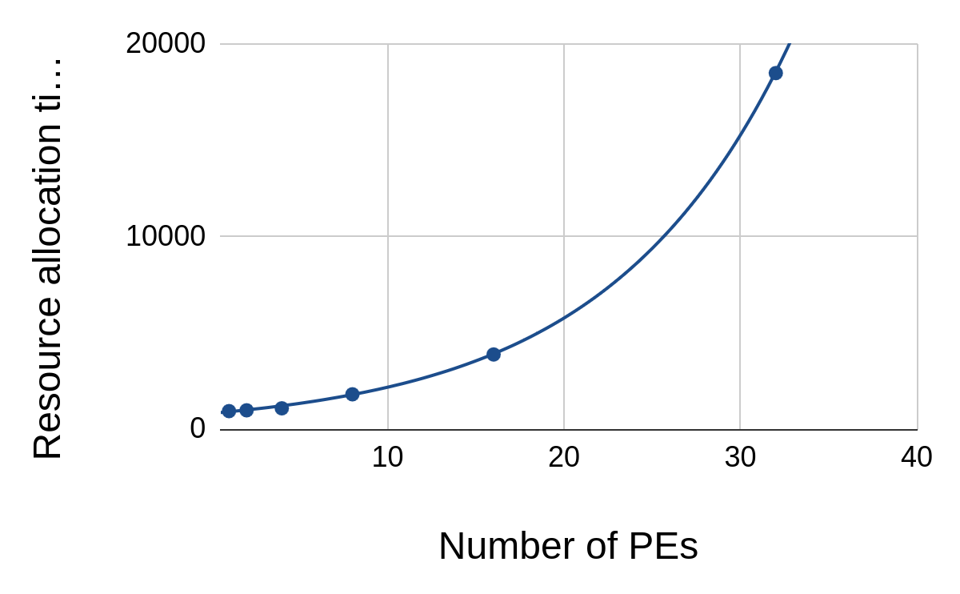

Adequation - Standard dataflow resource allocation
Introduction
time (s)
time (s)
: O(A.log(A)+P.(A+E))
!
Notes:
_________________________________________________
One of the major problems in parallel programming is that standard resource allocation time increases exponentially with the complexity of both application and architecture graphs.
As an illustration, the axes represent the resource allocation time according to number of actors in red and the resource allocation time according to number of processing element in blue.
For both the exponential trend is clearly visible.
Even when working on a single node, standard methods can become inefficient due to the time they take. So, it's important to accelerate the process on a single node before attempting to scale it up.

Slide 14




SKA objectives
How to optimize the execution of an astronomical application on HPC system
Improve Compilation
Improve Execution
Reliable Simulation
“at scale” Simulation
Notes:
______________________________________
These problems are obviously not compatible with the objectif of SKA.
To answer the leading question, I'm going to present several solutions for .
Improving compilation
Improve program execution
Provide reliable simulations
Enable large-scale simulations

Slide 15

Notes:
_____________________
And now the contributions

Slide 16
Outline
Contribution #1
1
2
3
Granularity optimization for multicore architecture
HPC resource allocation
HPC co-design
Notes:
Our goal is to provide astronomers with a tool that allocates resources and designs the HPC architecture that works all by itself.
But first we need to optimize resource allocation within an architecture node before scaling up.

Slide 17

Motivation
Contribution #1
Resource Allocation Time
Execution Time
Notes:
___________________________________________
For these first contribution, we aim to reduce the resource allocation time on a node, without compromising the performance of application on a parallel target, and even reduce its execution time.

Slide 18
Clustering to reduce graph complexity
Contribution #1
Flattening
DAG
Mapping
Scheduling
Timing
B0
x 1
x 4
x 2
C0
Core0
B0
B1
C0
B1
A
B
C
A0
B2
Core1
A0
B2
B3
C0
C1
B3
Parallelism(app) ≠Parallelism(archi)
Unnecessary parallelism
Notes:
Back to standard resource allocation.
sometimes the degree of parallelism of the application doesn't correspond to the target.
For example, B can be parallelized 4 times, but we only have 2 cores,
so the standard method overexposes the parallelism in the graph that is not necessary.

Slide 19
Clustering to reduce graph complexity
Contribution #1
Flattening
DAG
Mapping
Scheduling
Timing
B0
x 1
x 4
x 2
C0
Core0
B0
B1
C0
B1
Uncontrolled clustering leads to sequential application
A
B
C
A0
B2
Core1
A0
B2
B3
C0
C1
B3
Clustering
Flattening
DAG
Mapping
Scheduling
Timing
x 1
x 4
x 2
x 1
x 2
Ω0
Core0
Ω0
A0
A
B
C
A
Ω
2(B)C
Ω1
Core1
A0
Ω1
SDF: 7→ 3
DAG: 10→ 4
Notes:
An effective way of simplifying a graph is clustering, which consists in grouping actors according to defined rules to avoid deadlocks.
Here, clustering groups 2 actor B and one actor C into a single omega actor, which is repeated 2 times to preserve graph consistency.
The flat SDF graph is reduced to 7 to 3 actors.
The dag graph is reduced tfrom 10 to 4 actors.
This significantly facilitates mapping
But uncontrolled ...

Slide 20
Grain-Adaptive Dataflow Resource Allocation
Contribution #1
Core0
Shared Memory
Clustering
SCAPE 1,2,3
Standard Resource Allocation
Core1
x 1
x 2
A
ΩBC
Extraction
Mapping Scheduling
Timing
Translation
ΩBC(in){
for(i<2)
B(in,outB);
C(outB);
}
cluster.c
CPUx
B
B
C
Pattern ID
Subgraph generation
x 1
x 4
x 2
x 1
x 2
Aims to simplify the graph
while preserving and/or improving the necessary parallelism
A
B
C
A
ΩBC
x 2
x 1
B
C
SCAPE: Scaling up of Clusters of Actors on Processing Element
Notes:
__________________________________________
The method we propose , called scape, automate smart clustering and was the purpose of 2 extensions.
All of them operate upstream of the standard process and aims to simplify the graph while preserving and improving the necessary parallelism.
First the method Identify specific actor patterns in the graph.
Isolate them in a sub-graph, and adjust the tokens so that the sub-graph repetition match the number of processing cores.
Easilly compute the sub-graph schedule, given that the actors in a sub-graph will be mapped to the same processing element.
Generate C code from the subgraph, where repetition are converted into for loops and actors are transformed into function calls.
Replace the hierarchical actors with the generated code.
Then the method perform standard allocation using the simplified graph.

Slide 21
SCAPE1: Pattern ID Focus: Data parallelism
Contribution #1
Unique repetition Count (URC)
x 1
x 8
x 8
x 1
x 4
A
B
C
A
URC
x4 core
SDF: 17 → 5
//: 4 → 4
Notes:
______________________________
what differentiates the first 2 versions of SCAPE is the identification of particular actor patterns.
the first version focuses on matching excessive data parallelism to the target.
One pattern is URC, consists of a sequence of actors sharing the same repetition, the method identifies these actors, groups them, and plays with the tokens to match the target, here reducing the number of dataflow actors to be mapped from 17 to 5 while preserving parallelism for the target

Slide 22
SCAPE1: Pattern ID
Contribution #1
Unique repetition Count (URC)
Single Repetition Vector (SRV)
x 1
x 8
x 8
x 1
x 4
x 1
x 8
x 1
A
B
C
A
URC
A
B
C
x 1
x 4
x 1
A
SRV
C
x4 core
SDF: 17 → 5
//: 4 → 4
SDF: 10 → 6
//: 4 → 4
Notes:
_________________________________________
the SRV pattern is an isolated actor with excessive repetition, the clustering principle is the same as the previous one, and we reduce the number of actors to be mapped from 10 to 6 in this example.

Slide 23

SCAPE1: Granularity Configuration Method for Input Parameter
Contribution #1
Set of clustering configuration
Dataflow
Level of clustering
ℤ=[0; hierarchical levels + 1]
Notes:
____________________
The 2 fisrt version of scape take as input the dataflow and an input parameter corresponding to the level of granularity
And provide a set of clustering configuration alowing the user to choose the wanted granularity
The number of configurations equals the number of hierarchical levels plus two.

Slide 24
SCAPE1: Granularity Configuration Method for Input Parameter
Contribution #1
Input Graph
Ω
C
Ω
C
Ω
Pattern
Ω’
A
B
Pattern
0
1
2
3
Level of clustering
Complexity ++
Parallelism ++
Complexity --
Parallelism --
Notes:
____________________
In this example, with two levels, there are four possible configurations:
Level 0: corresponds to the standard graph with no clustering.
Level 1: SCAPE identifies patterns only at the lower level.
Level 2: the method coarse cluster the subgraph, and identify patterns at the top level.
Level 3: the entire graph is grouped into one actor, making the application sequential and easier to map.

Slide 25



Grain-Adaptive Dataflow Resource Allocation
Contribution #1
SCAPE1
Reduce data parallelism
SCAPE2
⊕Increase pipeline parallelism​​
SCAPE3
⊕Pattern matching to all admissible hierarchical level​​s
Notes:
______________
To clarify, the first version of SCAPE reduces excessive data parallelism on the number of target cores.
The second version extends the first by increasing parallelism on the sequential parts identified with clustering.
Version 3 applies pattern matching to all admissible hierarchical levels, providing only one clustering configuration tuned to the target.

Slide 26
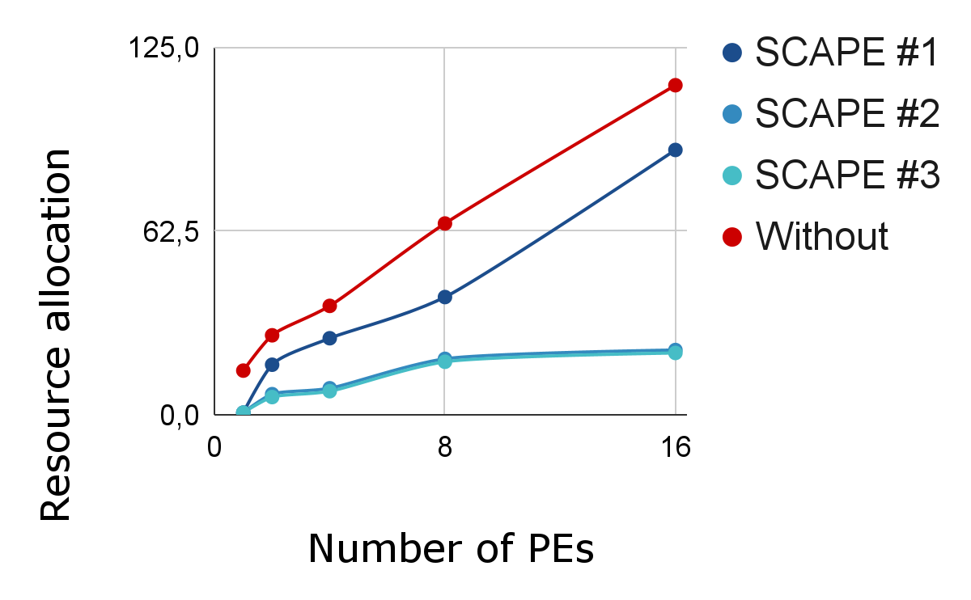
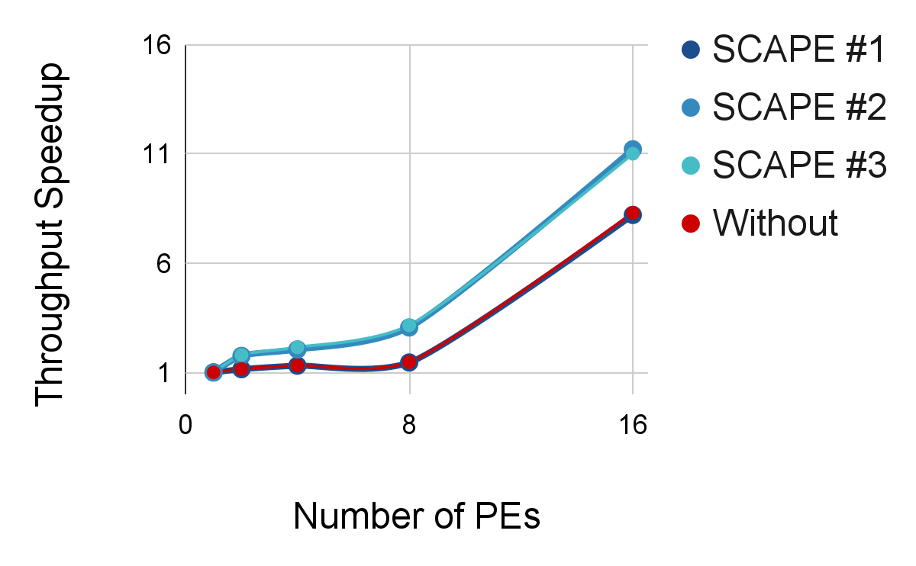

Comparative Analysis: SCAPE Methods vs. Without on Stereo Application Deployment
Contribution #1
Time (s)
Without
SCAPE2, 3
SCAPE1
SCAPE2, 3
Without, SCAPE1
SCAPEs always faster than without
SCAPE2 = SCAPE3 → same configuration
SCAPE1 = without → keep data //
SCAPE2-3 > without → add pipeline //
Notes:
________________
I'm going to compare the three versions of SCAPE with the method that doesn't have any optimization for deploying a DSP application.
Here the axes represent the resource allocation time according to the number of PE, the lower the better.
So all SCAPE version accelerate the process.
Here the axes represent the throughput speedup according to the number of PE, the higher the better.
SCAPE1 preserve application performance, overlapping the standard method
SCAPE 2 and 3 improve throughput, since we've added parallelism to the sequential parts.

Slide 27
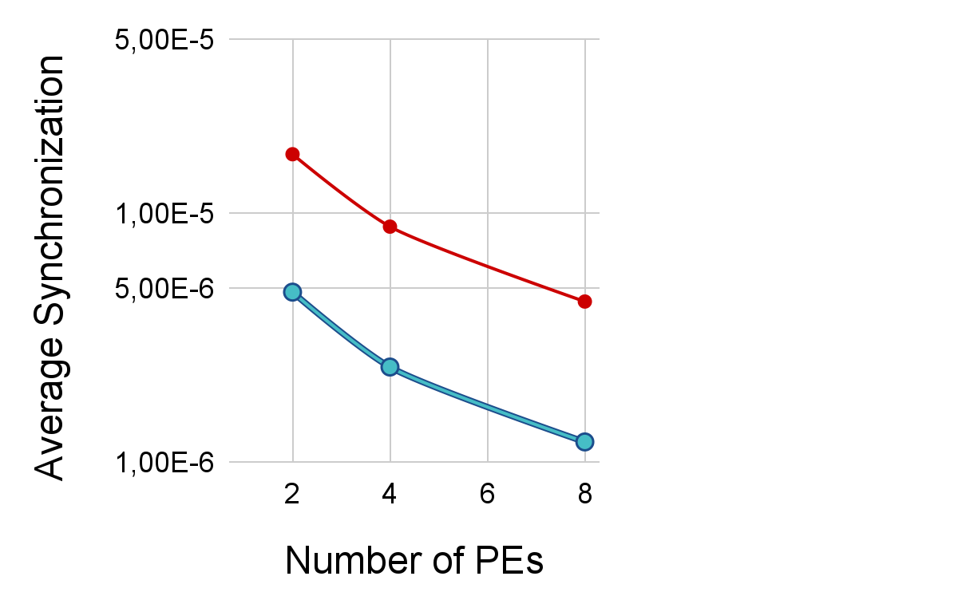
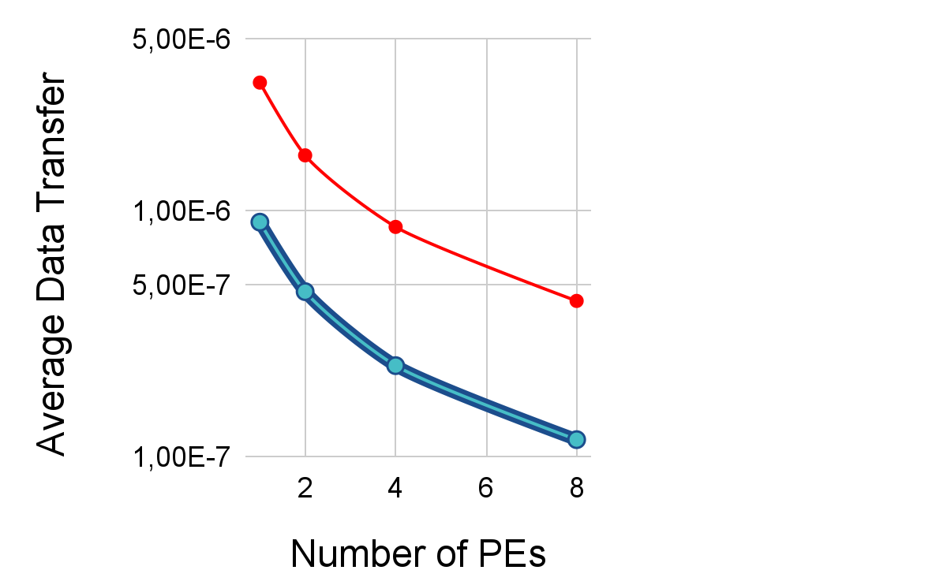
Comparative Analysis: SCAPE Methods vs. Without on Stereo Application Deployment
Contribution #1
Time (s)
Without
Without
SCAPE1,2, 3
SCAPE1,2, 3
Time (s)
SCAPEs ↘ communication overheads
SCAPEs ↘ synchronization overheads
Notes:
_________________________
Here the axes represent the average data transfer time per core according to the number of PE, the lower the better.
All SCAPE reduce communication overheads
Here the axes represent the average synchronization time between theads according to the number of PE, the lower the better.
All SCAPE reduce synchronization overheads

Slide 28


Take away message
Contribution #1
Improve mapping choice
Reduce resource allocation time
Reduce communication & synchronization overhead
Limited to single-node architecture
[1] O. Renaud, D. Gageot, K. Desnos, J.-F. Nezan. SCAPE: HW-Aware Clustering of Dataflow Actors for Tunable Scheduling Complexity, DASIP, 2023
[2] O. Renaud, N. Haggui, K. Desnos, J.-F. Nezan. Automated Clustering and Pipelining of Dataflow Actors for Controlled Scheduling Complexity, EUSIPCO, 2023
[3] O. Renaud, H. Miomandre, K. Desnos, J.-F. Nezan. Automated Level-Based Clustering of Dataflow Actors for Controlled Scheduling Complexity, JSA, 2024
Notes:
To summarize, I introduced SCAPE, a clustering method that optimize dataflow resource allocation within an node by:
Improving mapping choice
Reducing resource allocation time
Reducing overheads but is limited to single-node system.
This method has been the subject of 3 international scientific papers.

Slide 29
Outline
Contribution #2
1
2
3
✔ Granularity optimization for multicore architecture
HPC resource allocation
HPC co-design
Notes:
Now that we've optimized resource allocation on a node, let's move on to the next step: allocating resources on multiple nodes, that is on HPC systems.

Slide 30





Motivation
Contribution #2
Collaboration
HPC Multi-Node Resource Allocation
Notes:
___________________
This contribution was initially motivated by collaboration with 2 other organizations, the Australian astronomers at CSIRO and the IRISA laboratory, and our aim is to simulate and prototype HPC systems.

Slide 31
Multi-node S-LAM modeling
Contribution #2
Core0
Core1
Shared Memory
Node0
Core2
Core0 f0
Node1
Router
Distributed Memory
Core1 f1
Shared Memory
Core2 f2
Node2
Core0
Core3
Core1
Core4
Shared Memory
Core2
Core5
Notes:
______________________________ - To do so we needed to model mutli-node system with a graph.
we take advantage of the S-LAM model to represent homogeneity within a node, that is when all processing elements share the same characteristics.
In opposite a node is heterogeneous if it is made up of processing elements with different characteristics, for example 2 CPU cores with different frequencies.
I implemented in PREESM the S-LAM to represent Multi-node architectures that are architecture made up of several interconnected nodes, which leads to the structure of HPC systems.

Slide 32


Multi-Node CPU resource allocation
Contribution #2
Balanced-workload
Between nodes
Dataflow
SimSDP
S-LAM
Code
Notes:
_______________________
the method takes as input the dataflow, and the graph of the multinode system , target a balanced-workload partitioning between node and provide code for HPC systems.

Slide 33


Multi-Node CPU resource allocation
Contribution #2
Node workload
Node-Level Partitioning /Readjustment
Thread-Level Partitioning
Simulation
Clustering
SCAPE
Standard Resource Allocation
Iterative because 2 levels of resource allocation: within nodes and on the overall system
Notes:
__________________
The process is iterative since we have 2 level for allocating resources: within nodes and on the overall system.
and consists of 3 main steps
The method divides the application graph into sub-graphs, each associated with a node in the architecture.
then the SCAPE method is used for each node to adjust granularity.
then the Inter-node and intra-node behavior is simulated using a combination of two tools: simgrid and preesm.
iteratively, The method adjusts the graph construction based on feedbacks from simgrid to balance the workload among nodes.

Slide 34



Managing Heterogeneity to Achieve Balanced Workload
Contribution #2
Heterogeneous Node
≄ speed
≄ number
Notes:
_______________________
The method deals with standard heterogeneity, that is on systems made up of CPUs only, with different frequencies within the nodes, or with a varied number of cores.

Slide 35
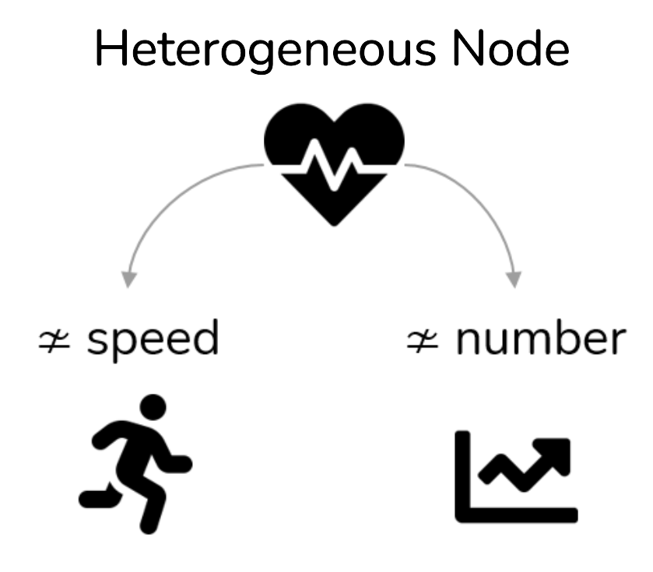

Managing Heterogeneity to Achieve Balanced Workload
Contribution #2
Node0
number of equivalent cores (Ceq0)= ∑ frequency ratios
estimated workload 0 = sequential time × Ceq0 / ∑Ceq
= ∑ actors in sub0
Node1
Node2
Notes:
_______________________
To achieve a balanced workload, we start by estimating the workload for each node.
To handle heterogeneous nodes, we simplify the problem by calculating the 'number of equivalent cores.' This involves summing the frequency ratios of the cores.
Then, the estimated workload per node is the proportion between the sequential execution time and the number of equivalent core. This determine the number of actor per subgraph.

Slide 36
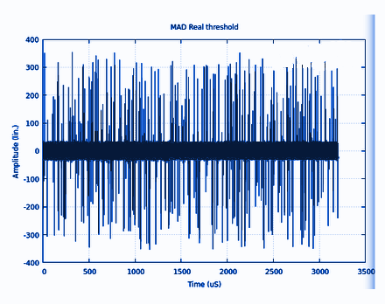

Use case in astronomy : Radio Frequency Interference (RFI) filter
Contribution #2
Amplitude
Amplitude
Time (us)
Dataflow
Time (us)
Noisy signal
Filtered signal
Massively parallel
Flexible complexity (DAG: 1415 → 1.4e7)
Notes:
______________________
As a usecase I model an astronomical application with the dataflow model.
Here an RFI filter take as input a noisy signal compute thresholds and remove noises outside threshold.
The dataflow model is massively parallel and I can easily play with the complexity depending on the size of the input file.

Slide 37
Simulation Results for 3 Multi-Node Architectures on the RFI Filter Application (1.4e7 actors)
Contribution #2
Archi#1
Archi#2
Archi#3
3 homogeneous nodes
3 heterogeneous nodes ≄ frequencies
3 heterogeneous nodes ≄ number of cores
Notes:
I'm going to evaluate the method deploying the filter on 3 multinode architecture.
The 1st one is homogeneous, the second one only the frequency between cores varies and the third one only the number of cores per node varies.

Slide 38
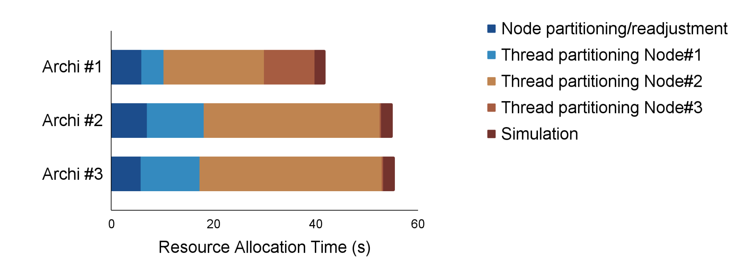
Simulation Results for 3 Multi-Node Architectures on the RFI Filter Application (1.4e7 actors)
Contribution #2
1 iteration ~ few min
Time ~ O(intra_node)
Notes:
Here the axes represent the resource allocation time according to the multinode architecture.
the method takes just a few minutes, whatever the input graph complexity.
Now the complexity of the problem only depend on the complexity within a node.

Slide 39
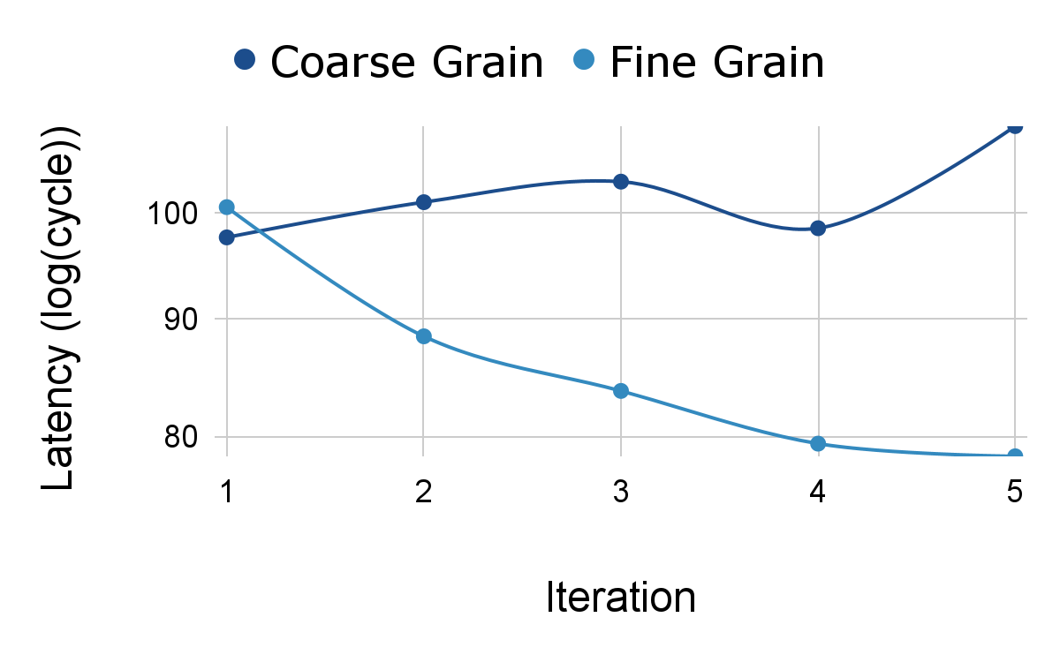
Iterative impact of the method over various granularity
Contribution #2
T(com)<<T(A) → directly reach optimum
T(com)>>T(A) → iteration relevancy
Notes:
Here the axes represent the simulated latency for each method iteration, the lower the better.
On coarse granularity, when communication lower than computation time the method quickly finds the best setup and keeps it.
otherwise the node readjustment will benefit to final latency

Slide 40
Take away message
Contribution #2
Established by previous contributions:
Improve mapping choice
Reduce resource allocation time
Reduce communication & synchronization overhead
New contribution:
Tackle multi-node architecture
Deployed and validated on Grid5000
Require architecture specification that may not be sized for the application
[4] O. Renaud, A. Gougeon, K. Desnos, C. Phillips, J. Tuthill, M. Quinson, J.-F. Nezan. SimSDP: Automatic Workload-Balancing on Multi-Node & Multi-Core HPC Architectures based on dataflow models, IETR CSIRO IRISA, under submission
Notes:
To summarize, I introduced a clustering method that optimize dataflow resource on multinode HPC system.
But, the method requires an input architecture description that may not be sized for the application.
This method has been the subject of 1 international scientific paper.

Slide 41
Outline
Contribution #3
1
2
3
✔ Granularity optimization for multicore architecture
✔ HPC resource allocation
HPC co-design
Notes:
Now that we've optimized resource allocation on HPC system, let's move on to the next step: designing the architecture.

Slide 42


Motivation
Contribution #3
Collaboration
Multi-node Architecture
Notes:
This contribution is also motivated by collaboration with Eviden for their expertise in HPC systems and to retrieve the ideal architecture.

Slide 43
HPC Architecture Definition
Contribution #3
Λ(Node, Core, Network) ⇒ρ(⌛,💾,🔋,💵)
Notes:
___________
First we define an architecture by a number of nodes, number of cores per node and a network topology.
And we want to find the one that offer the best latency and simulate memory, energy and cost.

Slide 44
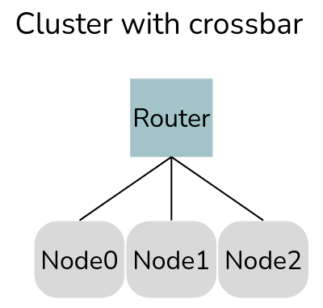
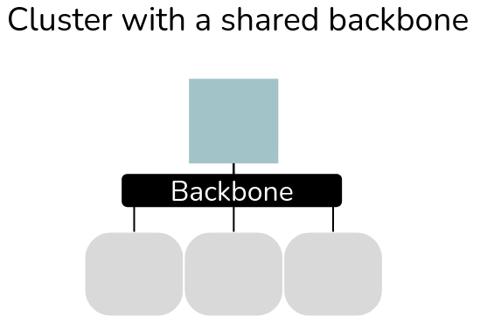
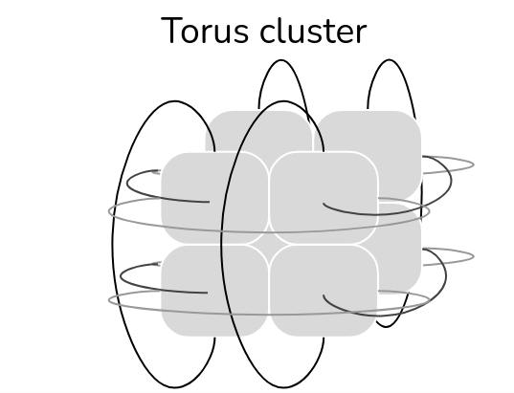
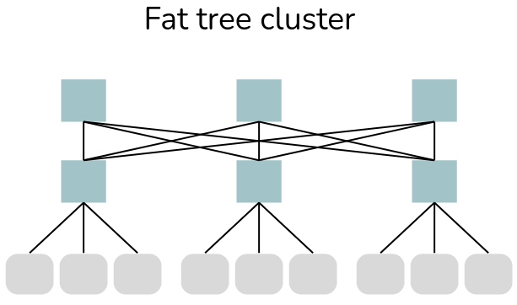
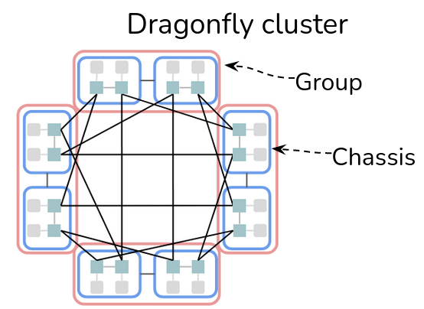
Modeling HPC Network
Contribution #3
Notes:
_________________________________
We extent our architecture model to also represent the main employed network topology with graph.
cluster with crossbar: nodes are connected to a central switch.
the cluster with shared backbone: nodes are connected to a central bar and share the same communication path.
torus: switchless cluster where each node is connected to its neighbor, effective for applications with regular communication patterns.
the fat tree: switches are organized on several rows, with redundant paths this allow to achieve high bandwidth.
dragonfly, an alternative to the fat tree for reducing network costs and surface area, is characterized by groups of nodes.

Slide 45
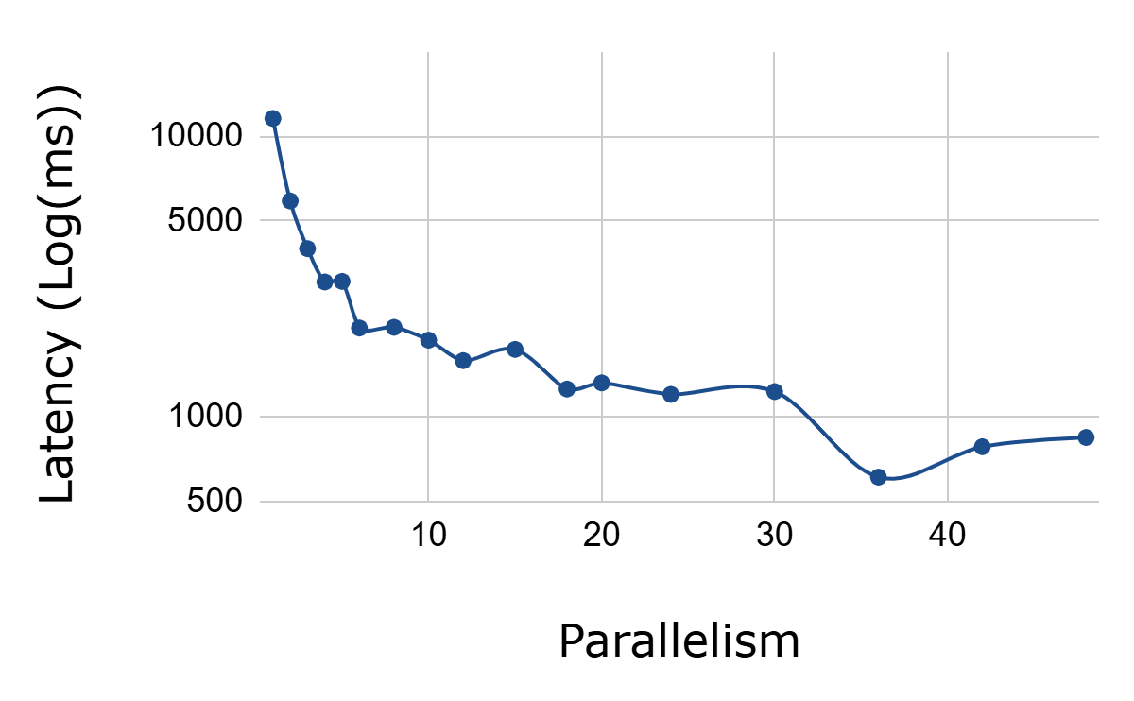
Final Latency Analysis in Deploying Sobel Application Across Architectures
Contribution #3
Number of PEs
Nodes x Cores
Notes:
_____________
Finding the parallelism that offers the best latency is not trivial.
Here the axes represent the latency obtained by deploying one DSP application on different architectures.
The trend is asymptotic, but admits several local minima.
We want to find the global minimum without simulating all possible cases.

Slide 46
Initial Simulations to Estimate Needs
Contribution #3
🔍Λ(Node, Core,Network) ⇒ρ(⌛,💾,🔋,💵)
Init{
}
for(Node<Nmax; Core<CMax;Network++){}
X1
core
💾 memory min => Node min
Notes:
_____________
To do so, the method starts with 3 initial simulations to estimate the needs of the application and set the boundaries next the simulation for loop.
It start to a simultion on a core to estimate memory requirements and set the minimum number of nodes required.

Slide 47
Initial Simulations to Estimate Needs
Contribution #3
🔍Λ(Node, Core,Network) ⇒ρ(⌛,💾,🔋,💵)
Init{
}
for(Node<Nmax; Core<CMax;Network++){}
💾 min => Nmin
X1
core
theoretical maximal speed up (Smax)
+pipeline
Notes:
__________________
on a core with a maximum number of pipelines, to estimate the maximum speedup

Slide 48
Initial Simulations to Estimate Needs
Contribution #3
🔍Λ(Node, Core,Network) ⇒ρ(⌛,💾,🔋,💵)
Init{
}
for(Node<Nmax; Core<CMax;Network++){}
💾 min => Nmin
theoretical Smax
X Smax
⌛target latency
Notes:
_____________________
on the theoretical maximum parallelism to estimate a target latency.

Slide 49
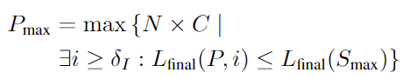
Iterative Simulations for Optimizing Parallelism
Contribution #3
🔍Λ(Node, Core,Network) ⇒ρ(⌛,💾,🔋,💵)
Init{}
for(Node<NodeMax; Core<CoreMax;Network++){
SCOPE adjustment:
}
Λ
⌛,💾,🔋,💵
Notes:
_____________
Then we enter a for loop of simulations where for each iteration, we recalculate the parallelism boundary and store the simulated key metrics
Parallelism boundary is define such as latency is no more decreasing during a delta iteration to avoid local minimal

Slide 50
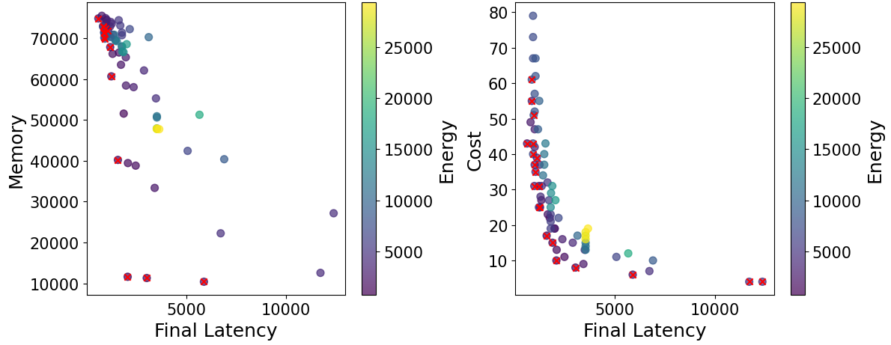
Comparison Analysis: Pseudo-exhaustive vs. Proposed co-design
Contribution #3
72 simu.​
52m 58 s​
Notes:
____________
Here the axes represent the final latency, memory, energy versus cost co-designing a DSP application with a pseudo exaustive methode

Slide 51
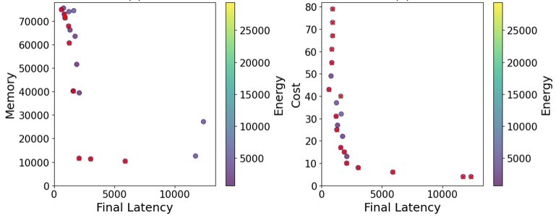
Comparison Analysis: Pseudo-exhaustive vs. Proposed co-design
Contribution #3
72 simu.​
52m 58 s​
22 simu.​
14m 26s
Notes:
____________
And here with the method
The number of simulation reduce from 72 to 22, requires less processing time to find the best latency architecture
and we preserve more than half of the pareto represented with red cross.

Slide 52
Comparison Analysis: Pseudo-exhaustive vs. Proposed co-design
Contribution #3
72 simu.​
52m 58 s​
22 simu.​
14m 26s
Reduce co-design process
(> half) Pareto-optimal architecture
Notes:
____________
And here with the method
The number of simulation reduce from 72 to 22, requires less processing time to find the best latency architecture
and we preserve more than half of the pareto represented with red cross.

Slide 53
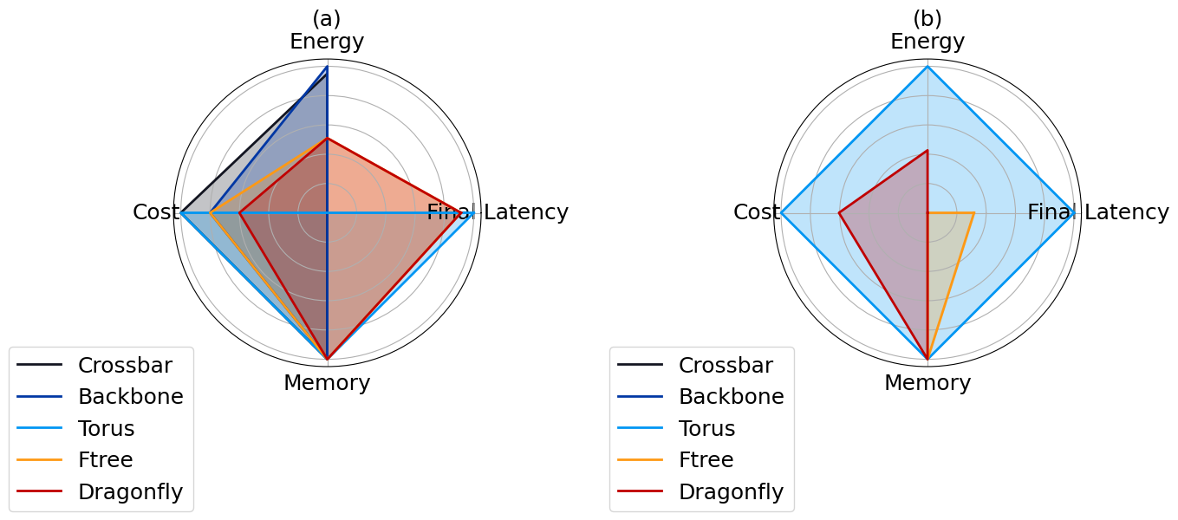
Analysis of network impact on small and bigger architecture
Contribution #3
Sobel
(6 nodes 6 cores)
Squeezenet
(24 nodes 6 cores)
The largest coverage the better
Multi-network analysis
Caution: default routing
Notes:
___
Here, we have a radar chart comparing different network topologies across four key metrics: energy, latency, cost, and memory. the largest coverage the better.
On a small application torus cluster offer best latency because of a regular communication structure and the fattree a better compromise
On a bigger application the torus offer both a better comprmise and the best latency because this application has a highly regular communication structure.
These results should be treated with caution, as routing is generated by default and could be added as a parameter for a more accurate search.

Slide 54
Take away message
Contribution #3
Established by previous contributions:
Improve mapping choice
Reduce resource allocation time
Reduce communication & synchronization overhead
Tackle multi-node architecture
Deployed and validated on Grid5000
New contribution:
Retrieve best architecture
[5] O. Renaud, K. Desnos, E. Raffin, J.-F. Nezan. SimSDP: Dataflow Application Distribution on Heterogeneous Multi-Node Multi-Core Architectures, EUSIPCO, 2024
Notes:
To summarize I introduce a clustering method that co-design dataflow application on multinode HPC system.
This method has been the subject of 1 international scientific papers.

Slide 55
Outline
Contribution #4
1
2
3
✔ HPC resource allocation
✔ HPC co-design
✔ Granularity optimization for multicore architecture
4
On going work:
Granularity optimization for modern architecture
Notes:
Untill now we deald with standard HPC system composed with CPU only. For our on going work we extend our work in order to support modern HPC system.

Slide 56

Motivation
Contribution #4
Collaboration
CPU-GPU Resource Allocation
Notes:
___________________
This contribution was initially motivated by collaboration with the Australian astronomers at Swinburne University and CSIRO , and our aim is to automate resource allocation on modern heterogeneous architecture.

Slide 57

Overview: Automated dataflow optimization for NVIDIA GPUs
Contribution #4
G-SLA
SCAPE
for GPU
Core0
Shared Memory
GPU
code for NVIDIA
GPU-accelerated architectures
Dataflow
x 1
x 4
x 2
A
B
C
G-SLA: GPU-oriented System-Level Architecture Model
[r]Saman Payvar, Maxime Pelcat, and Timo D Hämäläinen, « A model of architecture for estimating GPU processing performance and power »
*This work carried out by the intern I supervised, Ewen Michel, at Swinburne University and IETR as part as the Rising STAR project
Notes:
I will not detail the method for this presentation just give an overview.
The method take as input a special system level architecture model that allow to model internal parallelism of processing element and the dataflow. The method extend SCAPE to identify GPU-friendly pattern of actor
And generate code for acritecture accelerated by NVIDIA GPUs.
this work was carried out by my intern Ewen at Swinburne as part of a Rising star project.

Slide 58

Notes:
_____ And let's conclude

Slide 59




Summary conclusion
Conclusion
O. Renaud, D. Gageot, K. Desnos, J.-F. Nezan. SCAPE: HW-Aware Clustering of Dataflow Actors for Tunable Scheduling Complexity, DASIP, 2023
O. Renaud, N. Haggui, K. Desnos, J.-F. Nezan. Automated Clustering and Pipelining of Dataflow Actors for Controlled Scheduling Complexity, EUSIPCO, 2023
O. Renaud, H. Miomandre, K. Desnos, J.-F. Nezan. Automated Level-Based Clustering of Dataflow Actors for Controlled Scheduling Complexity, JSA, 2024
O. Renaud, A. Gougeon, K. Desnos, C. Phillips, J. Tuthill, M. Quinson, J.-F. Nezan. SimSDP: Dataflow Application Distribution on Heterogeneous Multi-Node Multi-Core Architectures, TPDS, under submission
O. Renaud, K. Desnos, E. Raffin, J.-F. Nezan. SimSDP: Dataflow Application Distribution on Heterogeneous Multi-Node Multi-Core Architectures, EUSIPCO, 2024
E. Michel, O. Renaud, K. Desnos, A. Deller, C. Phillips, J.-F. Nezan. Automated Deployment of Radio Astronomy Pipeline on CPU-GPU Processing Systems: DiFX as a Case Study, ADASS, 2024
1
2
3
HPC resource allocation
HPC co-design
Granularity optimization for multicore architecture
4
Granularity optimization for modern architecture
Implemented into PREESM and available on GitHub
Notes:
To summarize we provide astronomers with a method that allocates resources and designs the HPC architecture that works all by itself.
We first optimize resource allocation within an architecture node
Then we scaled up to optimize resource allocation on multi-node system.
Then we propose a method to retrieve the best architcture for a given application.
Finally we extend our granularity optimization for GPU accelerated architecture.
All method are implemented into preesm and available on github.

Slide 60
Perspectives
Conclusion
Improve resource allocation method for GPU acelerated architecture by adding key feature on the G-SLA
SCAPE
for GPU
Core0
Shared Memory
GPU
+ improve mapping choice
+ (cache size, memory usage ...)
x 1
x 4
x 2
A
B
C
Notes:
As future work. We could improve the previous work on a resource allocation method for GPU acelerated architecture by adding additional key feature such as cache size for the improving mapping choice as an example.

Slide 61
Perspectives
Conclusion
Improve resource allocation method for GPU acelerated architecture by adding additional key feature on the G-SLA
Improve data locality and cache utilization by automating the process of Loop reorganization taking advantage of existing polyhedral tools
SCAPE
Loop formation
isl/Pluto
Loop Reorganizer
APOLLO
Runtime manager
for(i<2)
…
for(i<2)
…
for(i<2)
…
for(i<2)
…
for(i<2)
…
for(i<6)
…
for(i<6)
…
APOLLO: Automatic speculative POLyhedral Loop Optimizer
Isl: Integer Set Library
[r] Raquel Lazcano López, « Automatic Runtime Performance Optimization Methodology Applied to Dataflow-based Hyperspectral Imaging Cancer Detection Algorithms »
Notes:
One other perspective can be improving data locality and cache utilization by automated the process of Loop reorganization taking bebefit from existing tools. As an example SCAPE could isolate loops or create them, isl is able to reorganise loop iteration and APOLLO already integrated into PREESM can select the best loop at runtime.

Slide 62
Perspectives
Conclusion
Improve resource allocation method for GPU acelerated architecture by adding additional key feature on the G-SLA
Improve data locality and cache utilization by automating the process of Loop reorganization taking bebefit from existing tools
Extend the resource allocation and co-design process on modern HPC system
Core0
SimSDP
Core1
Shared Memory
Node0
Core2
Core0
Node1
GPU
Shared Memory
FPGA
Ceq = f(GPU,FPGA)
Map= f(GPU,FPGA)
Notes:
Last perspective but not least is extending the resource allocation and co-design process on modern HPC system. One solution could be to compute the number equivalent core for accelerator and to consider computations restrictions while partitioning the application.

Slide 63

ophelie.renaud@insa-rennes.fr
Notes:
That's all for the presentation. Thank you for your attention.

Slide 64
Why not reuse the work on latency and throughput prediction for iterative resource allocation?
Hamza Deroui's thesis work | SimSDP
Embedded systems | HPC systems
Estimates throughput and latency upstream of the resource allocation process | Simulates metrics following optimized resource allocation process --> reliable
 | ANR project based on 2 existing tools: PREESM + SimGrid
✔ Faster X Less reliable | X Slower ✔ More reliable
Notes:
Another way to enable resource allocation on HPC systems would be to resume work on latency and throughput estimation, instead of relying on node workload simulation and workload rebalancing.
The work I'm referring to is that of Hamza Deroui, co-supervised by Madame President, and would enable a faster but surely less reliable process.

Slide 65
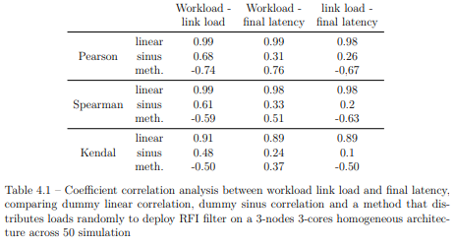
Why a balanced workload distribution?
1 = strong 0 = weak + = same trend - = opposite
✔ positive correlation
Pearson: linear corr. →same trend Spearman/ Kendal: monotonous →preserves order
Caution: correlation is true when application size is larger or match the target
✔ Data simulated by simgrid and actionable feedback
Notes:
The reason we rely on a balanced workload between nodes to achieve low latency is that there is a correlation between these two metrics.
For example, by deploying an RFI filter with a random distribution method to cover a maximum number of points, we can calculate the correlation using 3 different methods.
We obtain positive and strong correlations according to Pearson, which means that when workload deviation is low, latency is low.
These results should be taken with a grain of salt, however, since this tendency is true when the application size is larger or corresponds to the target.
And it's also an easily accessible and reliable metric from simgrid.

Slide 66
Simplified standard code vs. Cluster code
x 1
x 4
x 2
x 1
x 2
A
B
C
A
ΩBC
x 2
x 1
B
C
While(1){
A(outA);
//synchro
B0(outA,outB);
B1(outA,outB);
//synchro
C0(outB);
}
Core0.c
While(1){
//synchro
B2(outA,outB);
B3(outA,outB);
//synchro
C1(outB);
}
Core1.c
While(1){
A(outA);
//synchro
Ω0(outA);
}
Core0.c
While(1){
//synchro
Ω1(outA);
}
Core1.c
ΩBC(in){
for(i<2)
B(in,outB);
C(outB);
}
cluster.c
Standard on 2 CPU cores
Notes:
If we consider an ABC graph and 2 CPU cores.
I've represented here the simplified standard code where each thread file is associated with a CPU core, core0 is always the main thread, the while loop allows graph iteration.
threads are synchronized in PREESM via Pthread and computation with send and receive.
Here I've represented the code with optimized clustering and reduced synchronization.

Slide 67
Why hierarchy effectively isolate parts of a graph? IBSDF: a Composational Dataflow MoC
SDF > IBSDF > PiSDF
Hierarchical actor
A
2
Interfaces enables data transfer between hierarchical levels with specific firing rules
1
1
2
1
1
C
D
E
2
D
B
2
1
D_1
D_2
Insulate hierarchical levels and garantee the composability of the MoC
Each subgraphs are statically schedulable
IBSDF: Interface-Based SDF [r] Jonathan Piat, Shuvra S Bhattacharyya, and Mickaël Raulet, « Interface-based hierarchy for synchronous data-flow graphs »
Notes:
Hierarchy-based clustering is particularly effective with our dataflow MoC because they are compositional. The PiSDF model takes the hierarchy feature from the IBSDF model, where subgraphs communicate with higher levels via interfaces with a special set of firing rules. This allows subgraphs to be isolated and processed independently, without affecting the entire graph.

Slide 68

How complex can an astronimic dataflow application be?
1kB
1MB
x 1
x 4
x 1
x 1
x 4000
x 1
Read
Process
Write
Read
Process
Write
Depending on the size of the input file, its processing can be partitioned into samples that can be processed in parallel, thus increasing data parallelism.
The dataflow pipeline of the SKA is still being developed and researched for further parallelism.

Slide 69


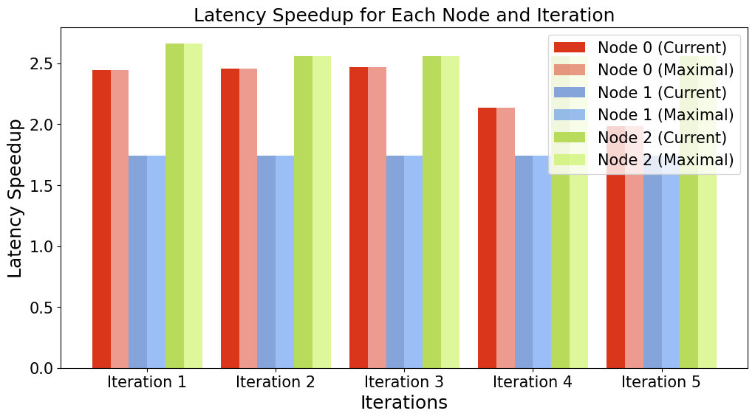
How close are the proposed methods to the target latency according to SKA constraints?
Real-time according to SKA community
we seek to parallelize as much as possible
Speedup = Latency on 1 core / Latency on x cores
Dream: Smax = number of cores
Acquisition Time = Processing time
Theory: Smax = sequential time / time of the critical path
Our simulations (RFI filter →3 multicore nodes) achieve the theoretical maximum speedup
The current bottleneck is the granularity of the application and exposing input parallelism
Notes:
SKA aims for real-time processing, where acquisition time matches processing time. Achieving this is challenging, especially with long acquisition times and large files. We focus on maximizing parallelism across machines to reduce core idle time. Ideally, speedup should equal the number of cores, with the theoretical limit being the sequential time over the critical path time. In our simulations, deploying the RFI filter on 3 multicore nodes achieves the theoretical maximum speedup. The current bottleneck is the granularity of the application and exposing input parallelism

Slide 70
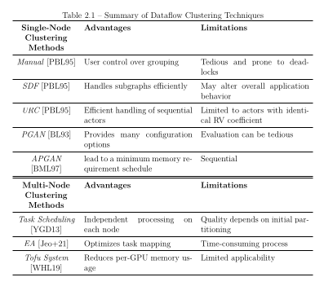
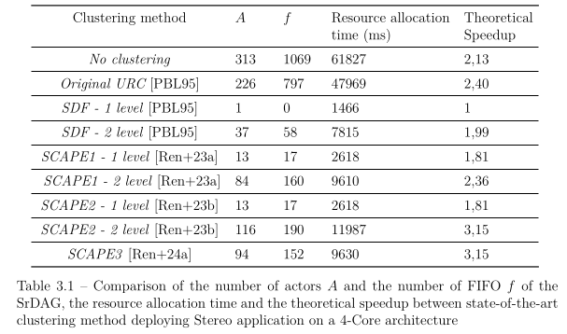
Comparison with existing methods for clustering on an architecture node
Existing methods are blind to architecture.
Some depend on the user's judgment.

Slide 71
Comparison with existing methods for clustering on multi-node architectures
Existing methods do not scale on complex applications

Slide 72
visibility refers to a key measurement that represents the correlation between signals received by two different antennas in an interferometer

